Slide 1


Web Scraping of
http://www.sortra.com/ryuji-shiba-puppy/

Slide 2
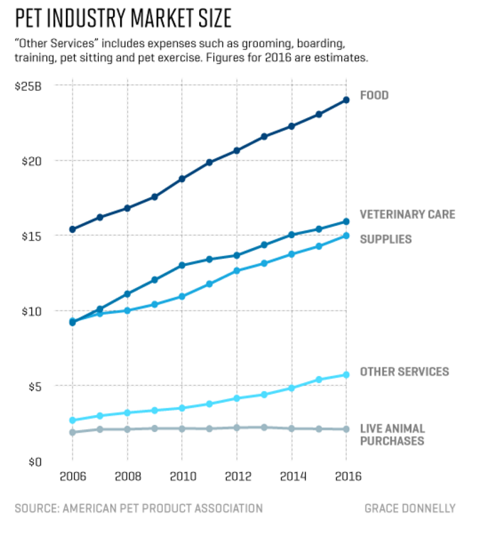
The pet industry has grown three-fold since 1996.
The pet industry continued to grow through the Great Recession (2007 – 2009)
http://fortune.com/2016/09/07/pets-are-basically-people/
https://www.washingtonpost.com/news/business/wp/2016/09/13/millennials-are-picking-pets-over-people/?utm_term=.ec61e57b7dfe
Notes:
Owners’ love for their pets has made the industry a resilient one. As president and CEO of the APPA, Bob Vetere has been tracking pet spending for decades. From 2007 to 2009, the heart of the financial crisis, the business of pets grew more than 10%. “People cut back on vacations, they cut back on the number of times they go out to eat, they cut back on a lot of other things -- but they’re not going to get rid of their pet,” he says.
http://fortune.com/2016/09/07/pets-are-basically-people/

Slide 3
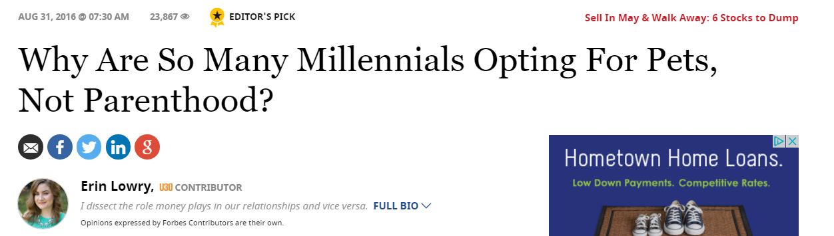


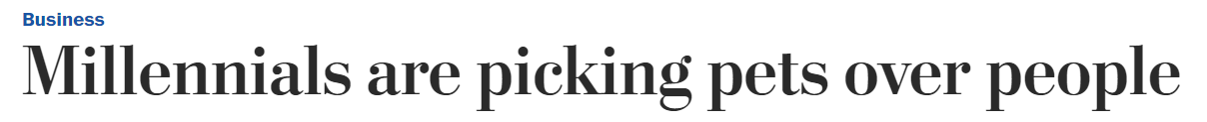

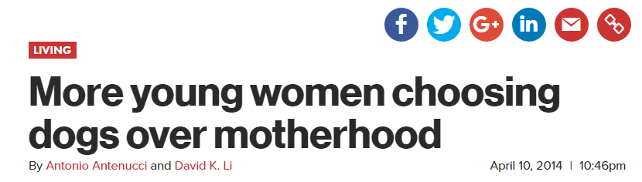
http://nypost.com/2014/04/10/more-young-women-choosing-dogs-over-motherhood/
https://www.forbes.com/sites/erinlowry/2016/08/31/why-are-so-many-millennials-opting-for-pets-not-parenthood/#50ff1f433963
https://www.washingtonpost.com/news/business/wp/2016/09/13/millennials-are-picking-pets-over-people/?utm_term=.ec61e57b7dfe
Notes:
Lifetime ocst of pet: $32,850
http://5kids1condo.com/3-ways-tech-can-save-you-money-pets/
Lifetime cost of child: $233,610
http://money.cnn.com/2017/01/09/pf/cost-of-raising-a-child-2015/
Millennial men more likely to have pets

Slide 4
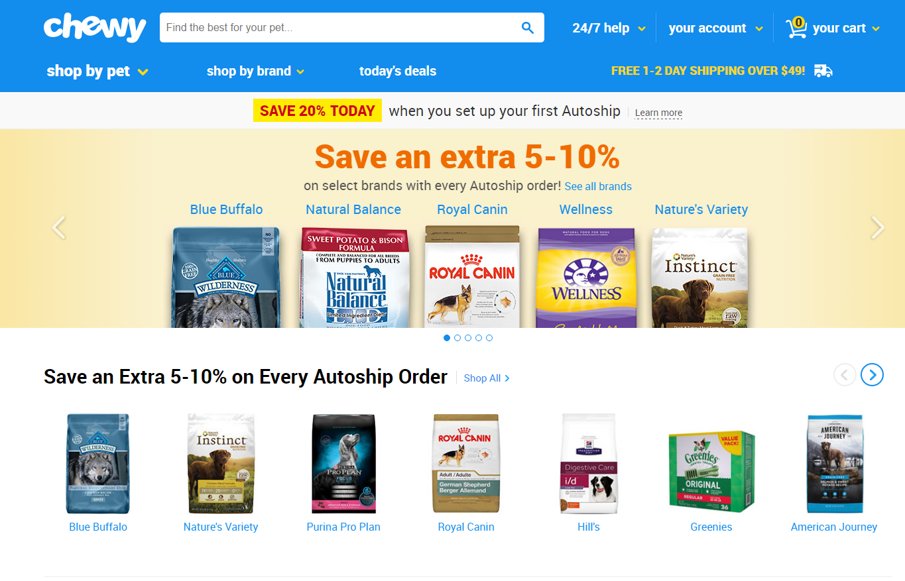

Slide 5
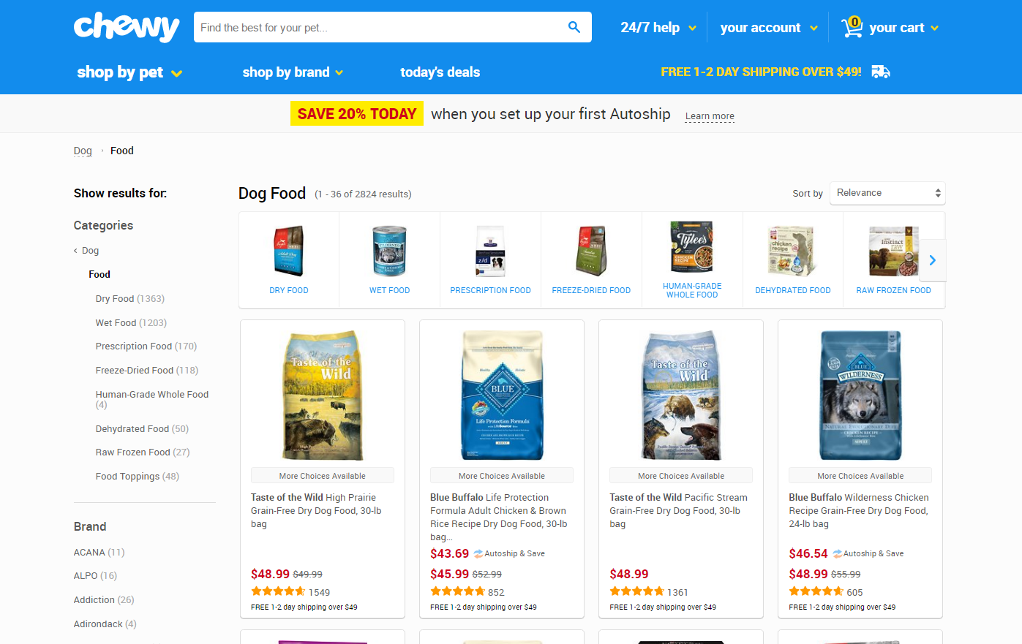
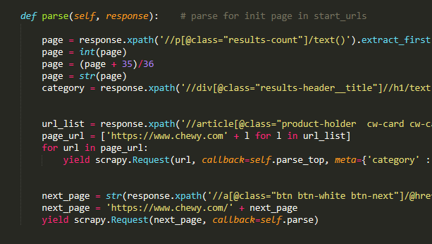

Slide 6
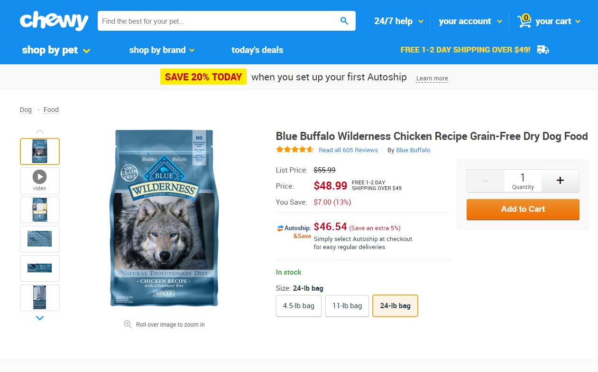

Slide 7
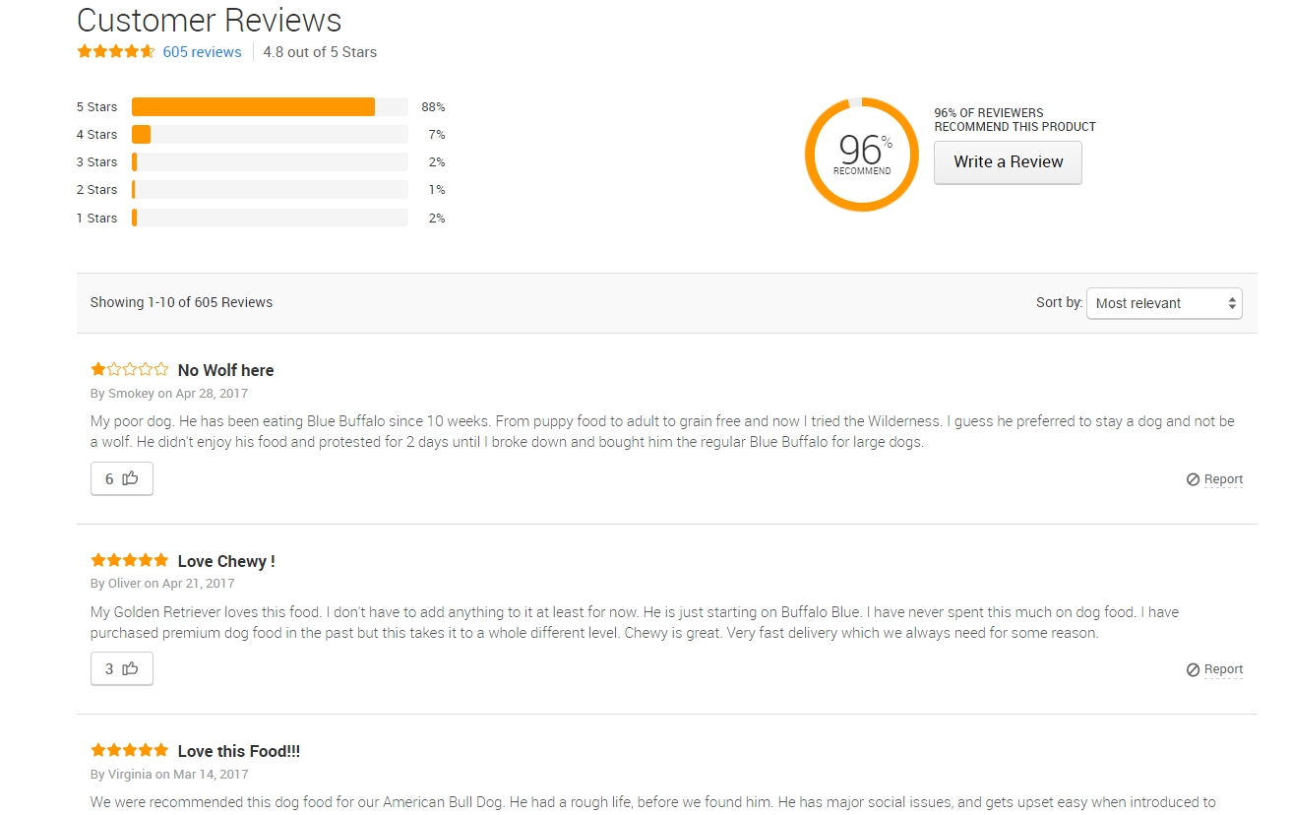
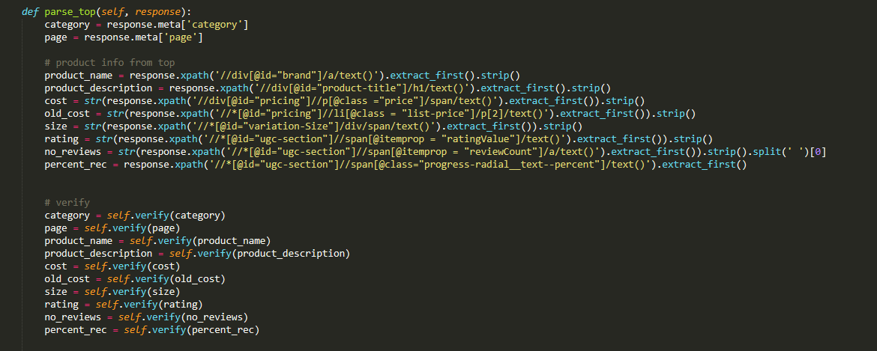

Slide 8
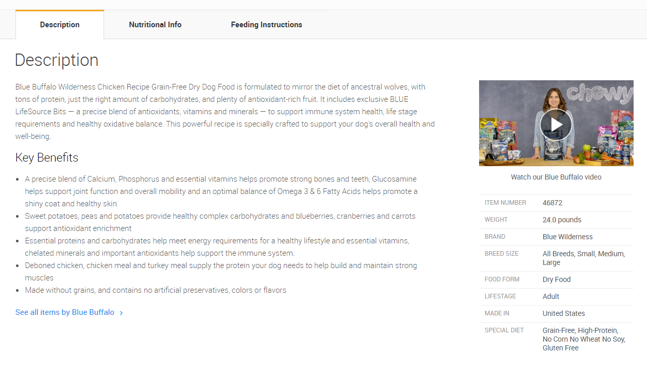
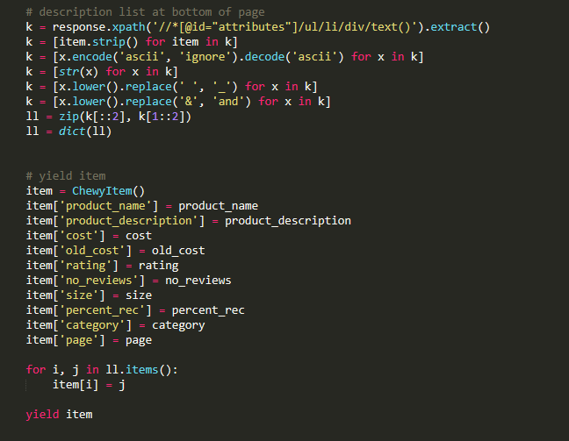

Slide 9
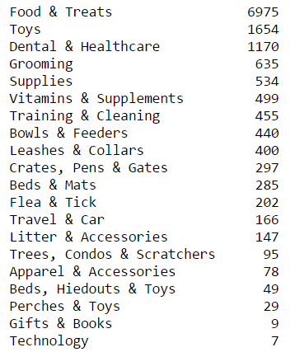
Cleaning and Pre-processing the Data
Numeric columns
Pet and Item Type
Missing Values
Notes:
Food & Treats had average rating of 4.53 (second highest after gifts & books),
Toys had lost average rating at 3.98 (only one below 4)
Dental & Healthcare had average rating of 4.47 (4th highest)

Slide 10
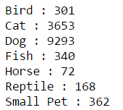
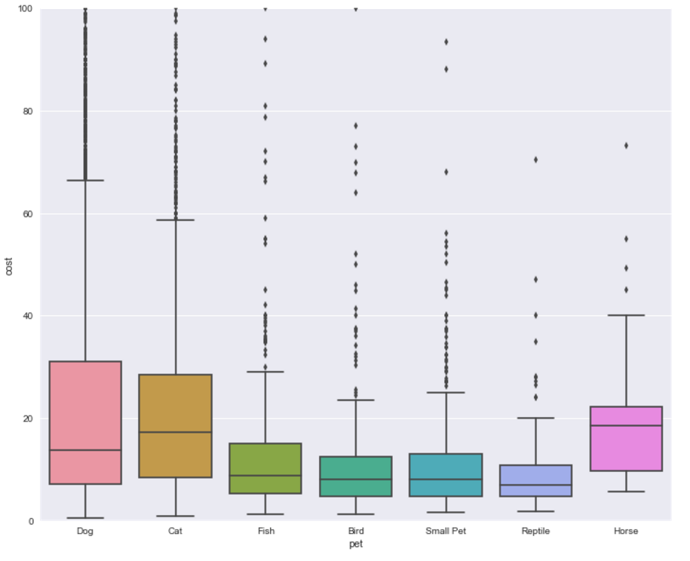
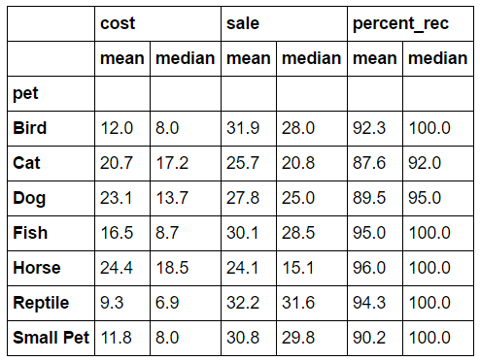

Slide 11

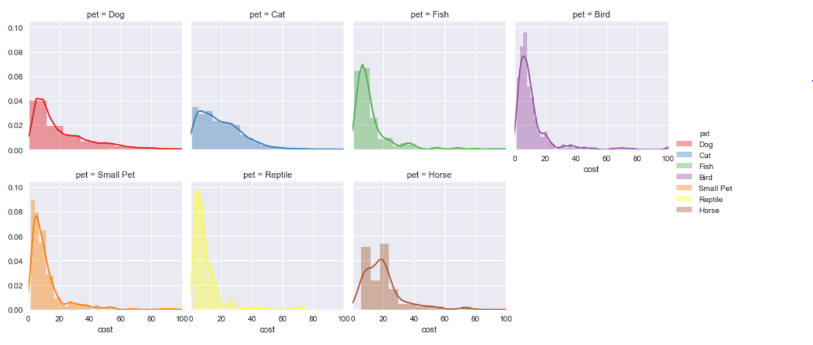

Slide 12
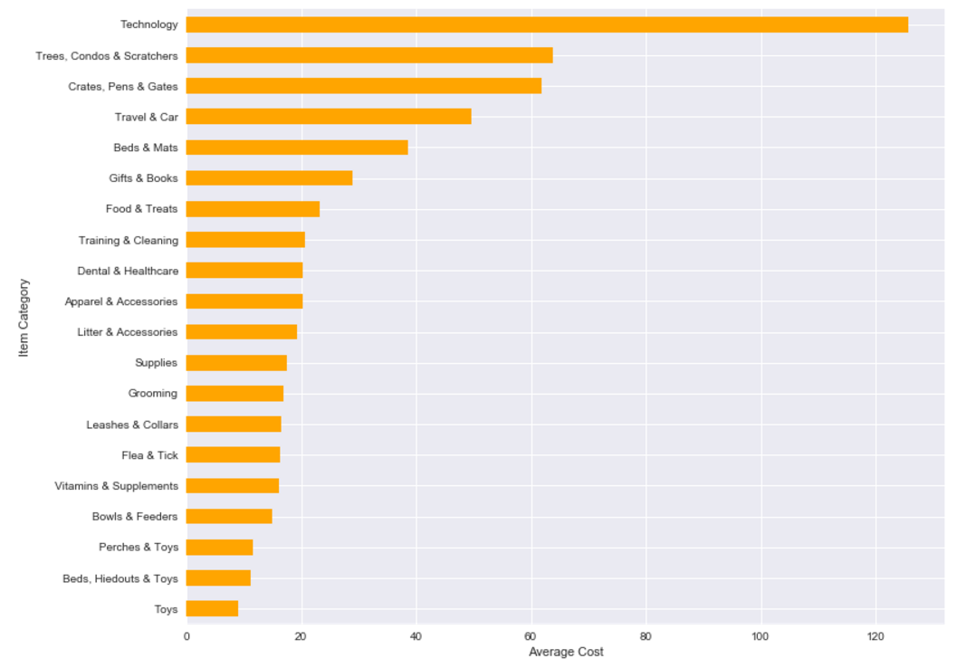
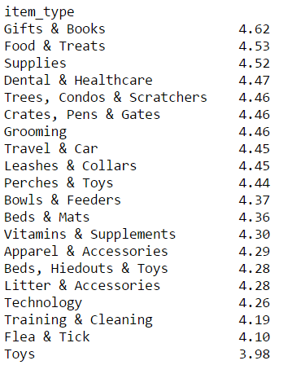
Notes:
Food & Treats had average rating of 4.53 (second highest after gifts & books),
Toys had lost average rating at 3.98 (only one below 4)
Dental & Healthcare had average rating of 4.47 (4th highest)

Slide 13
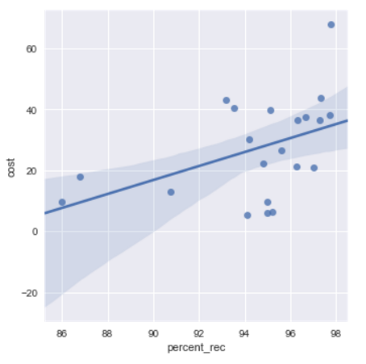
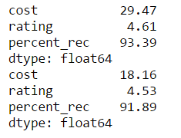
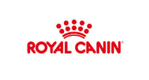
Most Reviewed Dog Food Brands:
Recommendation Rates vs. Cost
Special diet:
Normal diet:
Highest number of reviews, 4.82 rating, $67 average price
Notes:
Nearly three-quarters (69%) of Millennial pet owners are more likely to consider foods whose recipes use naturally-made ingredients over “normal,” mass-produced foods, versus fewer than half (44%) of owners over 35.
https://www.packagedfacts.com/Content/Blog/2017/02/07/1-in-3-US-Pet-Owners-Millennials-What-it-Means-for-the-Pet-Food-Market
http://www.adventuretravelnews.com/the-millennial-generation-is-changing-the-way-we-travel
they travel on average 4.2 times per year compared to 2.9 and 3.2 times per year for older generations.
Scientific messaging wors better for millennials and emotional messaging works better for boomers

Slide 14
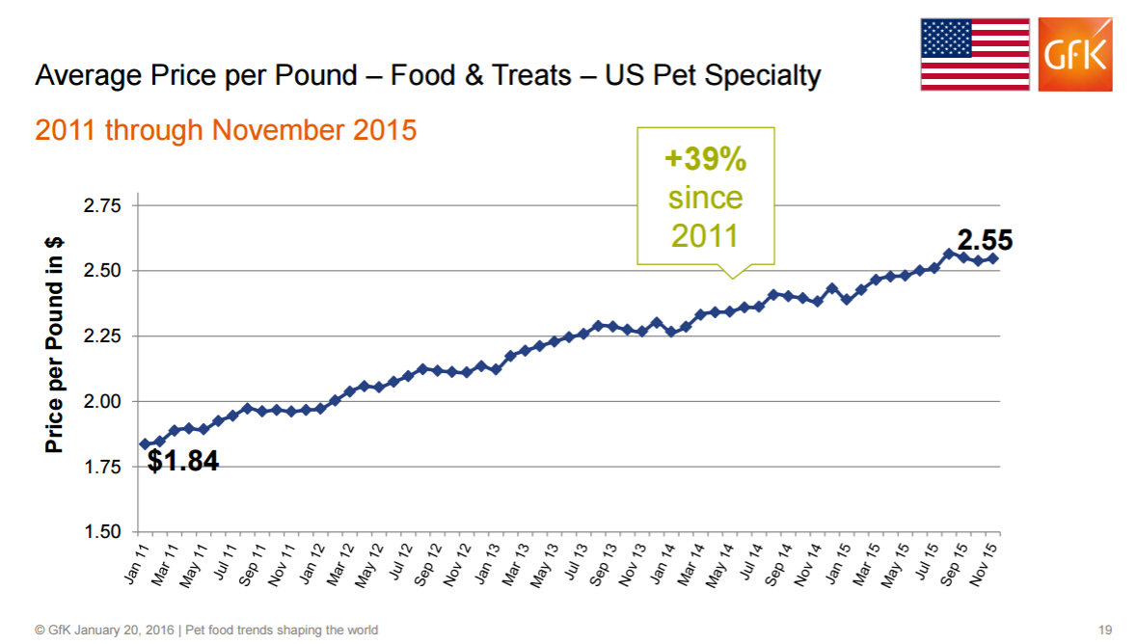
https://pida.memberclicks.net/assets/PILC16presentations/pilc%20lange%20petfood%20trends%20shaping%20the%20world.pdf

Slide 15
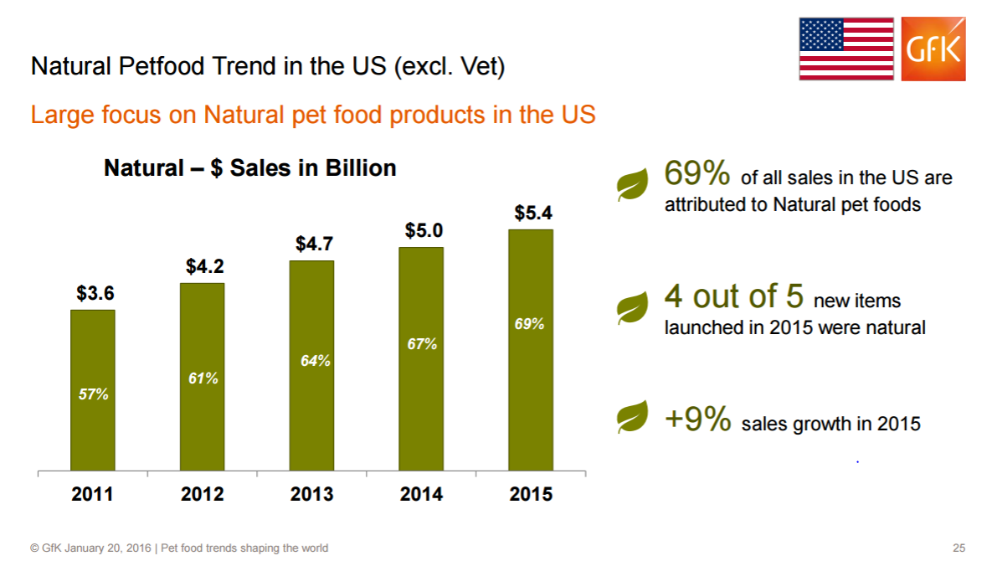

Slide 16
Conclusions:
Pet owners care about quality:
Prefer natural foods
Prefer recommended brands
Willing to pay significantly more
Chewy should
feature nutrition more significantly
look into other areas for high quality products for millennial pet owners (travel, grooming)
Notes:
Top page videos on the best diet for your dog & why
Scientifically proven
Suggestions for top-rated healthy choices

Slide 17
Future Work and Further Questions
Product sales
Trends over time
Textual analysis of reviews
Comparison to other online pet supply stores
Notes:
Personal developments:
I used python for everything to get the experience, but I would like to choose more effectively between R and python in the future
Scrape something more challenging, more items, tougher layout, ads involved, bots
Experiment with Bokeh and more statistical analysis

Slide 18


Any Questions?
https://www.lifewire.com/internet-famous-dogs-3485776

Slide 19
Thank You

Slide 20
